Slide 1

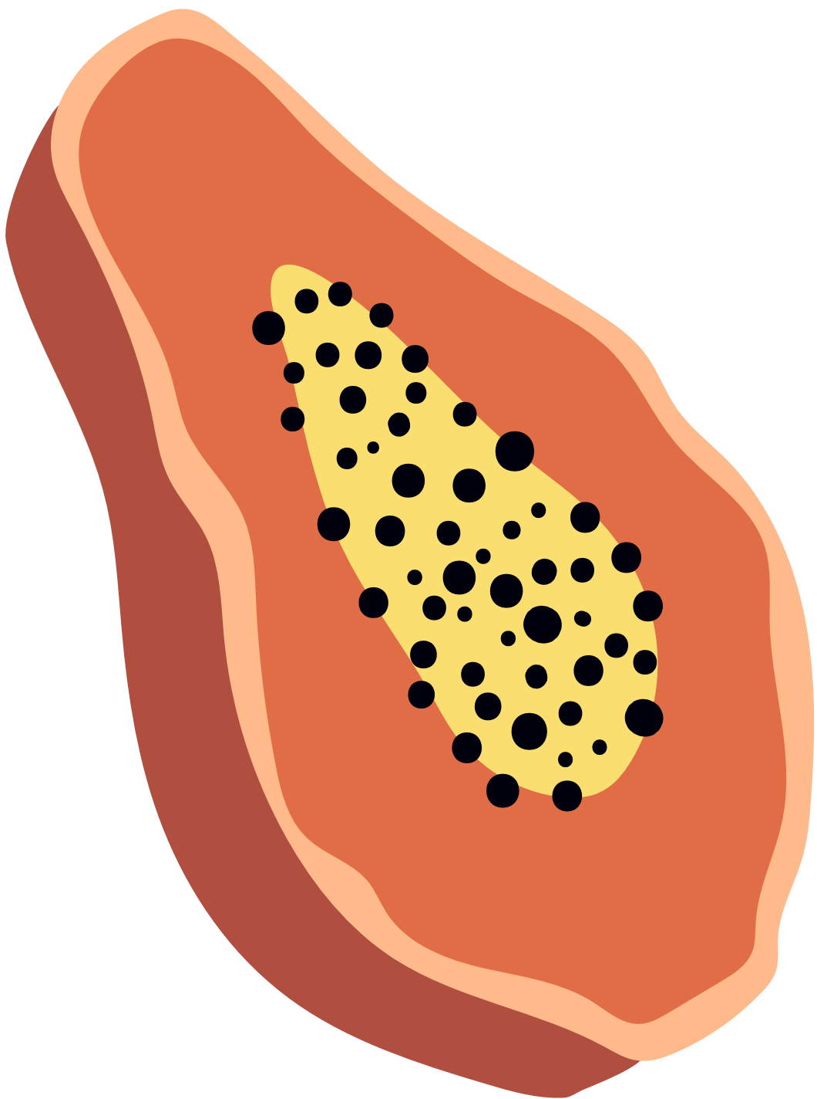



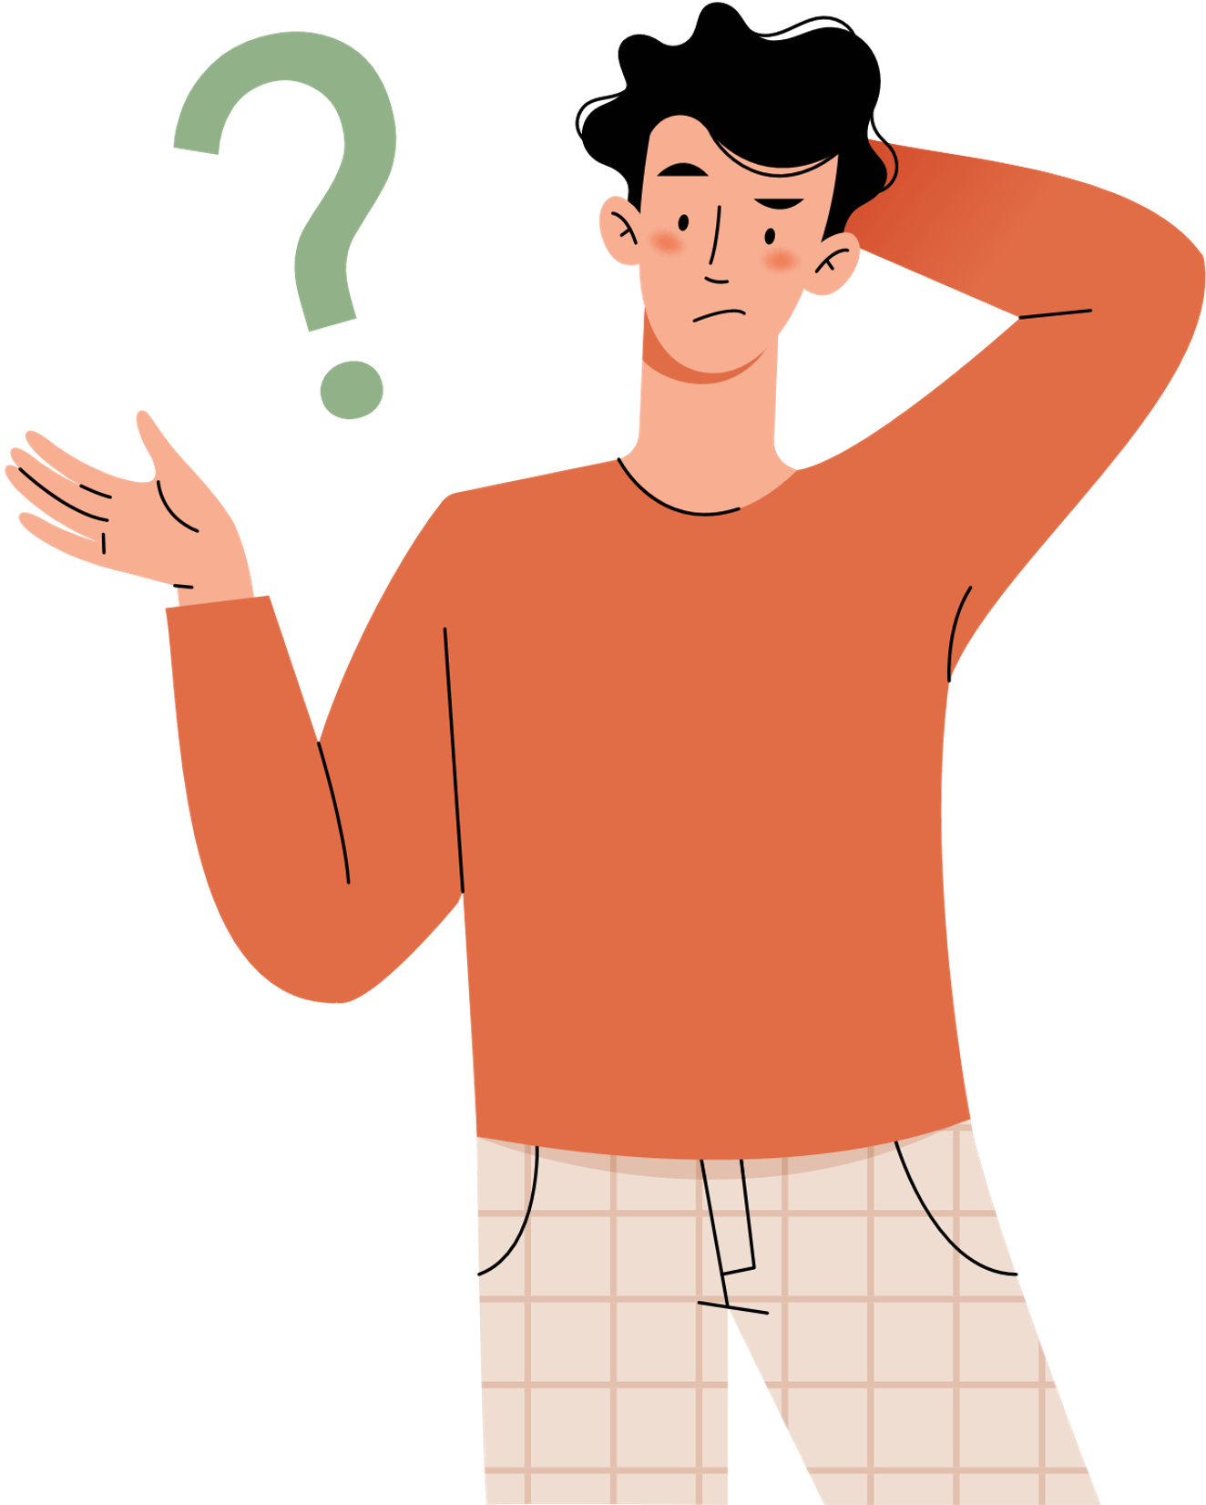

Masturbation
Online Lesson

Slide 2

What is masturbation?
Who does it?
Why?
How?
Myth busting!
In this lesson...

Slide 3




What is masturbation?

Slide 4
Masturbation
When you use parts of your own body and/or objects to feel sexual pleasure. [1] [2]
"solo-sex"
Mutual masturbation
= masturbation with a partner. [1] [2]

Slide 5
Masturbation
When you use parts of your own body and/or objects to feel sexual pleasure. [1] [2]
"solo-sex"
Safest form of sex!
You know what feels best.
No risk of pregnancy.
No risk of STBBIs. [3]

Slide 6

Masturbation is private
= safe, comfortable,
& with privacy. [4]
Private
vs
Secret
Not secret
= something you hide,
or that makes you feel
ashamed. [4]

Slide 7
Who does it?
Why?
All sorts of people.
For all sorts of reasons.

Slide 8
Who?
All sorts of people...including:
non-binary folk
people in relationships
trans women
people with disabilities
people who do not have partner sex
gay people
sexually active people
asexual people
young people
single people
cis men
straight people
trans men
etc.

Slide 9
Why?
For all sorts of reasons...including:

Slide 10
Why?
For all sorts of reasons...including:
to release stress
boredom
to figure out what you like
to help them sleep

Slide 11
Why?
For all sorts of reasons...including:
to release stress
to explore their sexual orientation
boredom
to explore their romantic orientation
to figure out what you like
connect with your body

Slide 12
Why?
For all sorts of reasons...including:
to affirm their gender
to release stress
to explore their sexual orientation
boredom
to distract themselves
to explore their romantic orientation
to figure out what you like
to ease pain
connect with your body
to have an orgasm
to help them sleep

Slide 13
Why?
For all sorts of reasons...including:
to affirm their gender
instead of partner sex
to release stress
to explore their sexual orientation
boredom
to distract themselves
curiosity
to explore their romantic orientation
to figure out what you like
to ease pain
to explore fantasies
connect with your body
to have an orgasm
to help them sleep
etc. [4] [5]

Slide 14

Why?
For all sorts of reasons...including:
to affirm their gender
Not everyone has an
orgasm when they masturbate!
instead of partner sex
to release stress
to explore their sexual orientation
boredom
to distract themselves
curiosity
to explore their romantic orientation
to figure out what you like
to ease pain
to explore fantasies
connect with your body
to have an orgasm
to help them sleep
etc.

Slide 15
Why not?
Some people do not masturbate at all.
They may not feel ready.
They may not enjoy masturbation.
They may never feel the need or desire to masturbate.
They may have specific familial, cultural, or religious values about masturbation. [4]

Slide 16
Too little or too much?
Everyone is different.
Can I become addicted to masturbation? No.
BUT some people masturbate "compulsively."

Slide 17
Too little or too much?
Compulsive
behavior
Everyone is different.
  Doing it all the time.
  Trouble thinking about other things.
  Gets in the way of work, school, and important life events. [6]
Can I become addicted to masturbation? No.
BUT some people masturbate "compulsively."

Slide 18

Compulsive
masturbation
Talk to someone.
Don't ignore bad feelings! Or good ones!

Slide 19
How do people masturbate?

Slide 20

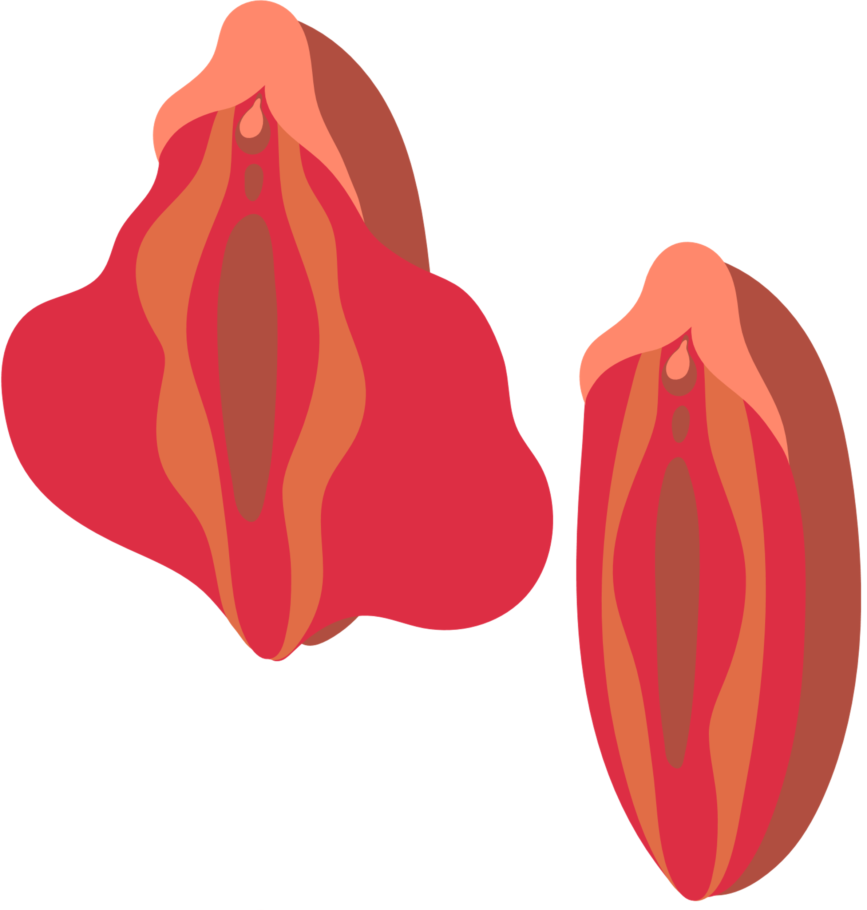
How do people masturbate?
Erogenous zone
A body part that makes you feel sexual pleasure.

Slide 21
How do people masturbate?
Erogenous zone
Body part that makes you feel sexual pleasure.
Not all about genitals! [5]

Slide 22

How do people masturbate?
Erogenous zone
Body part that makes you feel sexual pleasure.
There is no "right" way to do it
How? Petting, rubbing, stroking, etc.
Where? Vulva (clitoris, labia majora, labia minora), vaginal opening, perineum, anus, penis, scrotum. [5]

Slide 23
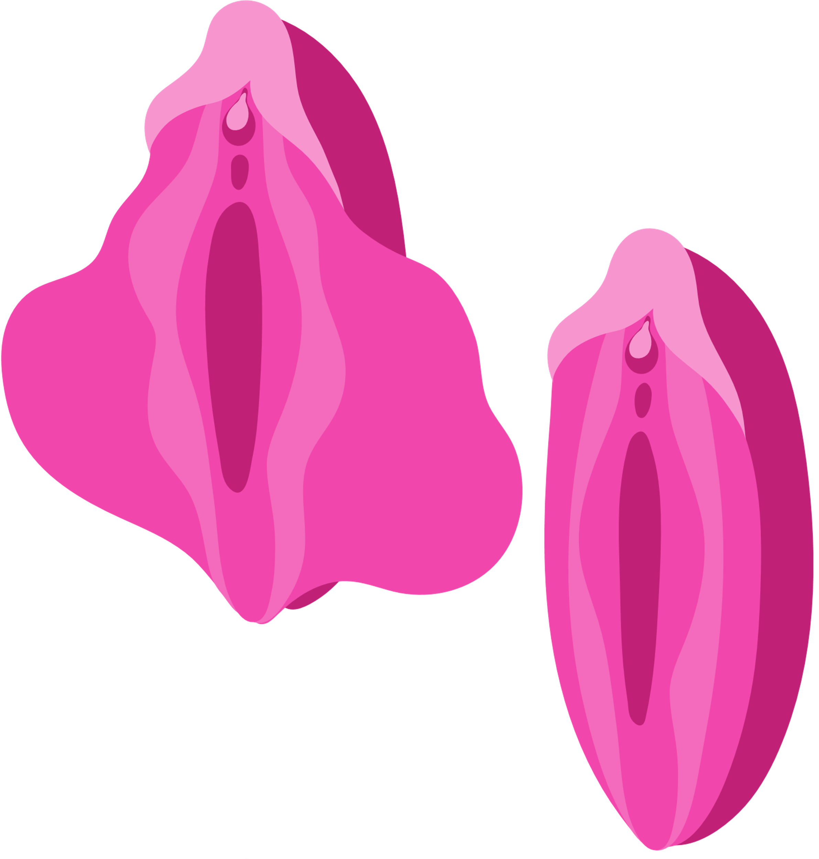
How do people masturbate?
Not everyone likes genital stimulation!
Transgender people may experience gender dysphoria (when body parts don't match gender).
Cisgender people might also experience discomfort
with their genitals.

Slide 24
How do people masturbate?
What can they do?
  Focus on gender affirming fantasies.
  Focus on fantasies that do not involve genitals.
  Wearing clothes during masturbation.
  Covering certain body parts.
  TRUSTING YOUR FEELINGS. [7]

Slide 25
A few quick tips...

Slide 26

A few quick tips...
  Wash your hands.

Slide 27
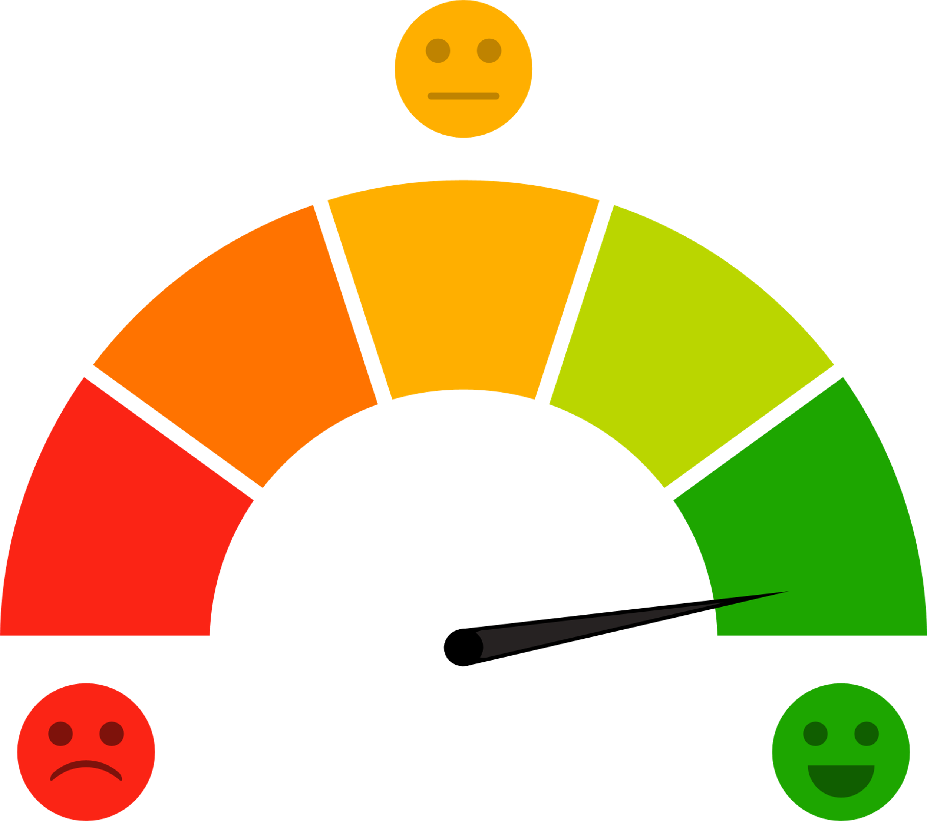
A few quick tips...
  Wash your hands.
  Check-in with yourself.

Slide 28
Masturbation is not bad for you!
Myth Busting!
Masturbation is linked to:
  lower stress and lower anxiety,
  better sleep,
  pain reduction,
  better immune functioning,
  better mood,
  greater focus and concentration,
  better self-esteem. [9]

Slide 29
More myths!
Going Solo: The Basics of Masturbation by Heather Corinna on Scarleteen
“Est-ce que les vibrateurs peuvent nous désensibiliser? » et 3 autres mythes sur la masturbation by Léa Séguin on SexU (French resource)
Masturbation: Fact of Fiction by Corinne Werder on TeenVogue:
https://www.teenvogue.com/story/masturbation-fact-fiction
Sex, Pleasure, and Sexual Dysfunction by Planned Parenthood
Myth Busting!

Slide 30
References
[1] School of Sexuality Education. (2021). Sex ed: An inclusive teenage guide to sex and relationships. Walker Books.
[2] Queering Sex Ed. (n.d.). Sex Acts That Don’t Get Enough Play. Retrieved June 29, 2022, from https://teenhealthsource.com/wp-content/uploads/2019/10/Sex-Acts-final.pdf
[3] Planned Parenthood. (n.d.). Is masturbation good for you? Retrieved June 28, 2022, from https://www.plannedparenthood.org/learn/teens/sex/masturbation/masturbation-good-you#:~:text=Masturbating%20is%20the%20safest%20sexual,t%20give%20yourself%20an%20STD
[4] Action Canada for Sexual Health & Rights. (2017) Beyond the Basics: A resource for educators on sexuality and sexual health. 3rd ed.
[5] Corinna, H. (2019). Going Solo: The Basics of Masturbation. Scarleteen. https://www.scarleteen.com/article/bodies_sexuality/going_solo_the_basics_of_masturbation

Slide 31
[6] DiNuzzo, E. (2021, March 22). Is Masturbation Addiction Real? What Experts Want You to Know. The Healthy. https://www.thehealthy.com/sex/masturbation-addiction/
[7] Them. (2021, June 23). 11 Ways To Deal With Gender Dysphoria During Sex. Them.us. https://www.them.us/story/11-ways-to-deal-with-gender-dysphoria-during-sex
[8] Action Canada for Sexual Health & Rights. (n.d.). Masturbation. Retrieved June 29, 2022, from https://www.actioncanadashr.org/resources/sexual-health-info/hub/masturbation
[9] Huizen, J. (2020, October 27). How does masturbation affect the brain? Medical News Today. https://www.medicalnewstoday.com/articles/masturbation-effects-on-brain

Slide 32

Other sources
  Perineum. (n.d.). In Merriam-Webster online. Retrieved June 29, 2022, from https://www.merriam-webster.com/dictionary/perineum
  Planned Parenthood. (n.d.). Masturbation. Retrieved June 29, 2022, from https://www.plannedparenthood.org/learn/sex-pleasure-and-sexual-dysfunction/masturbation
Developed by Taylor Gadoury
in collaboration with the Sexual Health Network of Quebec. 2022.

