Slide 1


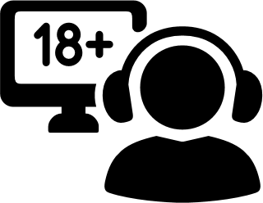






Media Literacy & Pornography
Online lesson
Notes:
Media Literacy & Pornography

Slide 2



Media Literacy & Pornography
  Media literacy;
  Pornography literacy;
  Pornography (what is it?);
  How porn portrays sexual relationships;
  How porn portrays people.
In this lesson
Notes:
In this lesson we will define media literacy as well as pornography literacy, look at how pornography is defined in different ways, and discuss how porn portrays sexual relationships and the people involved in them.

Slide 3



Pause the lesson.
Read the question.
Think about it.
Talk about it.
Reflection Qs
[Media literacy question.]
Notes:
Whenever you see the purple pause symbol, pause the lesson, read the reflection question, think about the answer and write it down. In a classroom setting, discuss your answers as a group.

Slide 4

What is media literacy?

Slide 5

Media literacy
A skill where you learn to look for, understand, evaluate, and create media. [1]
Media is anything that conveys information on a large scale. [2]
E.g.: website, television, radio, social media, etc.

Slide 6
The Core Concept of Media Literacy
All media is constructed.
All media has...
...someone who makes it.
...a medium and format.
...a goal.
...an audience.
...and represents specific values and points of view. [1]

Slide 7

Media is everywhere.
Why is media literacy important?
We are exposed to it everyday.
We use media
to communicate.
Media influences our
thoughts and opinions.

Slide 8

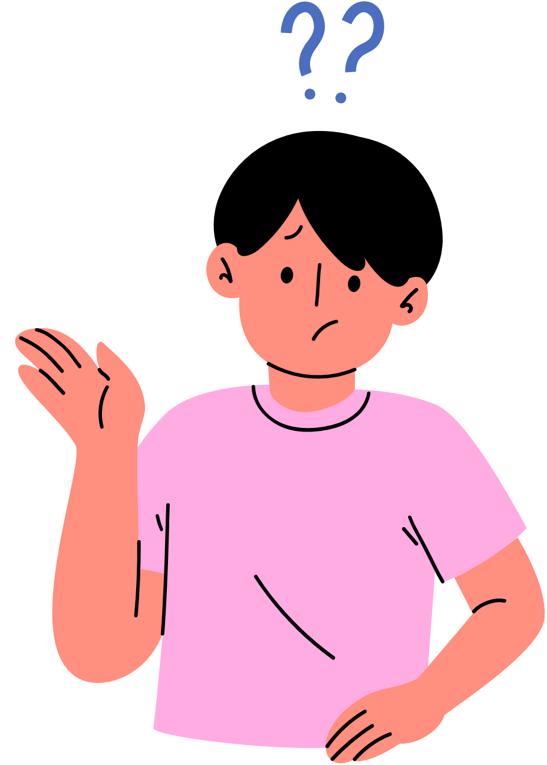
What is pornography literacy?

Slide 9

Main assumption:
Pornography is constructed.
Pornography literacy
PORN
All media has...
...someone who makes it.
...a medium and format.
...a goal.
...an audience.
...and represents specific values and points of view. [1]
A type of media literacy.

Slide 10
People watch porn.
Why is
porn literacy important?
The Internet makes pornography very accessible.
Pornography literacy is a valuable skill.

Slide 11

Some information about porn...
  What is pornography
  Who watches it?
  Is it addictive?

Slide 12


What is pornography?
Sexually graphic and/or explicit content that is made to sexually arouse its viewer. [3][4]
Examples:
erotic novels, erotic audio porn, porn magazines, porn films and videos, etc.

Slide 13

What is pornography?
Not everyone agrees.
Art
or
Porn?
The Toilet of Venus ("The Rokeby Venus")
by Diego Velázquez
Source: https://www.nationalgallery.org.uk/paintings/diego-velazquez-the-toilet-of-venus-the-rokeby-venus

Slide 14
Mainstream Pornography
Porn that is illegal.
  Video format.
  Anonymous.
  Hard to regulate.
  On large streaming websites.
  Child pornography.
  Non-consensual porn. [5][6]

Slide 15



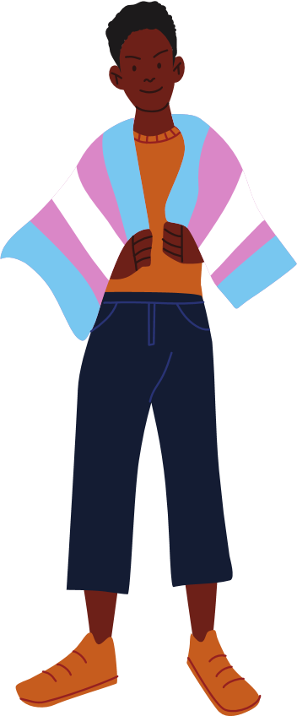
Who watches pornography?
Who is it made for? 18+
Why?
Curiosity.
To get aroused.
To explore their sexuality.
Who watches it? People of all ages.

Slide 16
Who watches pornography?
Ultimately, it is a personal choice.
Who is it made for? 18+
Why?
Curiosity.
To get aroused.
To explore their sexuality.
Who watches it? People of all ages.

Slide 17
No.
NOT a recognized mental health disorder or addiction. [7]
Can you
become addicted
to porn?
Compulsive use is possible. [8]
If you feel like watching porn is taking over your life,
talk to someone.

Slide 18
Porn sex:
Fact or Fiction?

Slide 19


Porn sex:
Fact or Fiction?

Slide 20


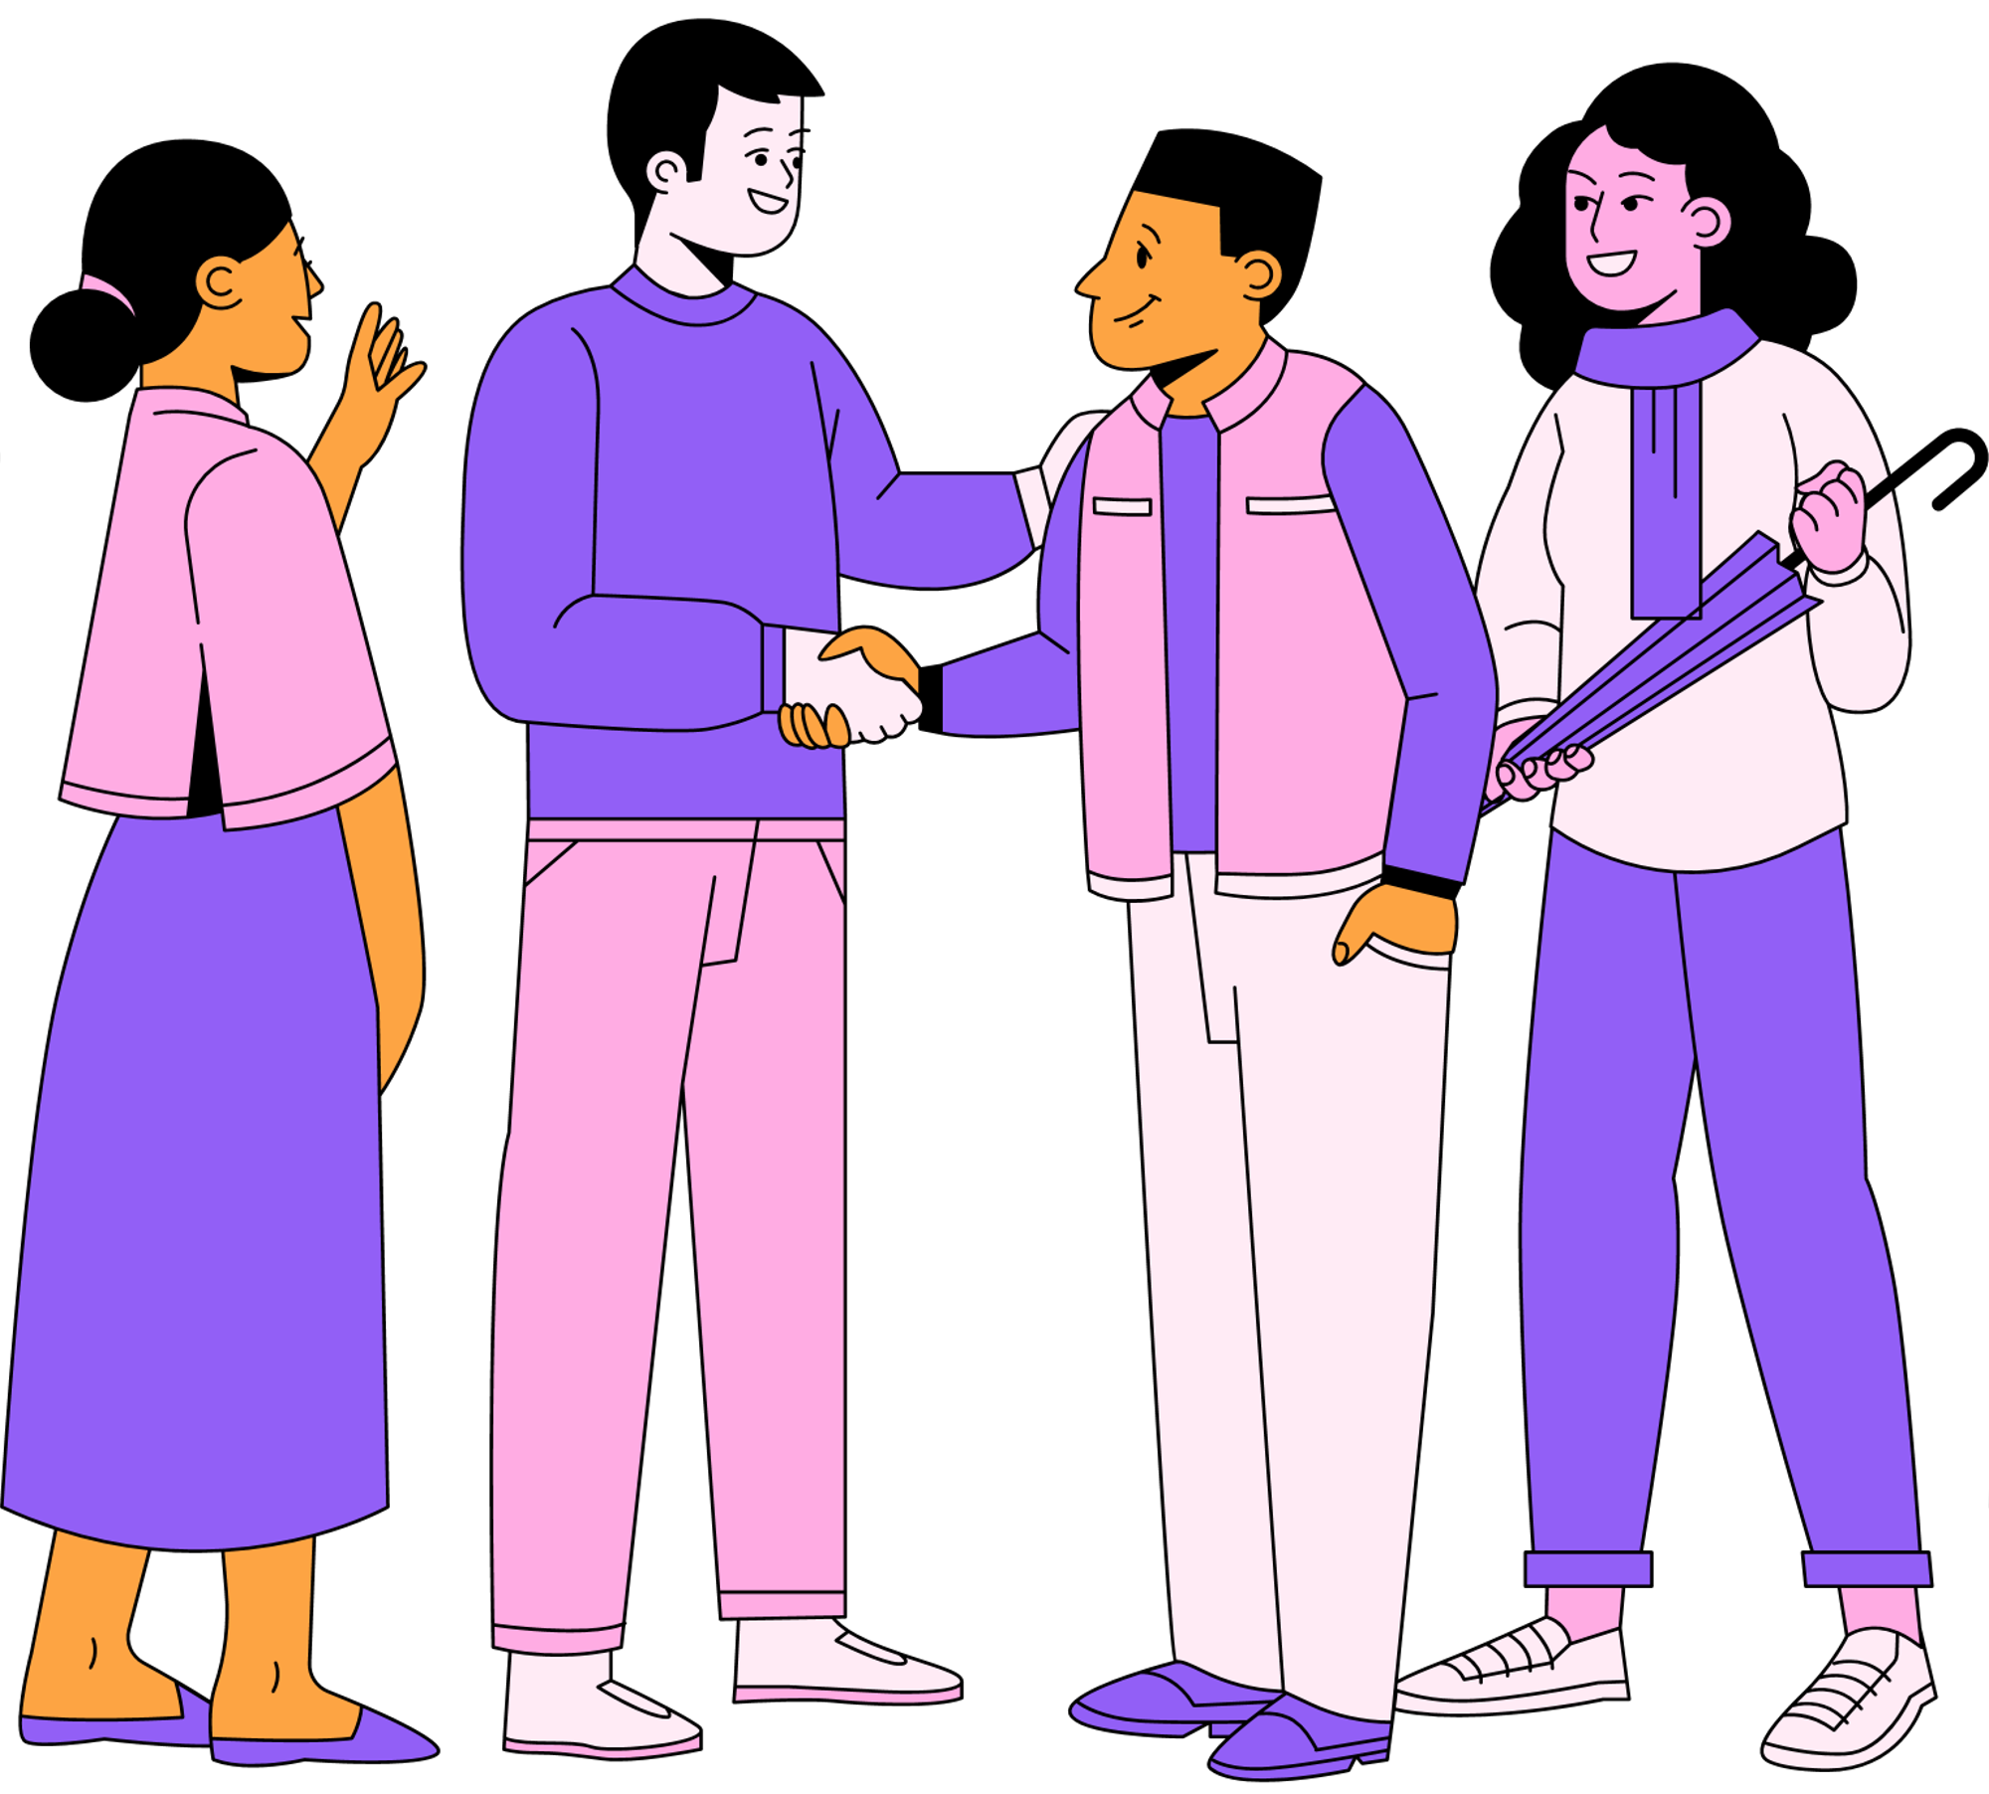
In real life...but rarely in porn
  People have body hair. In all sorts of places.
  People ask for consent before touching their partners.
  People use condoms and talk about other forms of contraception.
  People pause during sex and check-in with their partner.
  People have conversations about their likes and dislikes before they have sex.
  People engage in foreplay.
  People of all ages, levels of ability, genders, and sizes have sex.

Slide 21




When producing a pornographic film...
  Actors in pornography follow strict workout routines and diets. [9]
  The actors get body hair removed, fake tans, makeup, hairstyling, manicures, etc. [10]
  The actions, words, and sounds of the actors are scripted and choreographed.
  A whole crew of people are behind the cameras.

Slide 22
Porn sex:
Fact or Fiction?
See next slide for a hint!
Reflection Qs
What other types of media present versions of sex or intimate relationships that are incomplete or unrealistic?

Slide 23
Porn sex:
Fact or Fiction?
Reflection Qs
HINT: Do you know any television shows, movies, or magazines that have incomplete or unrealistic portrayals of sex and intimate relationships.

Slide 24


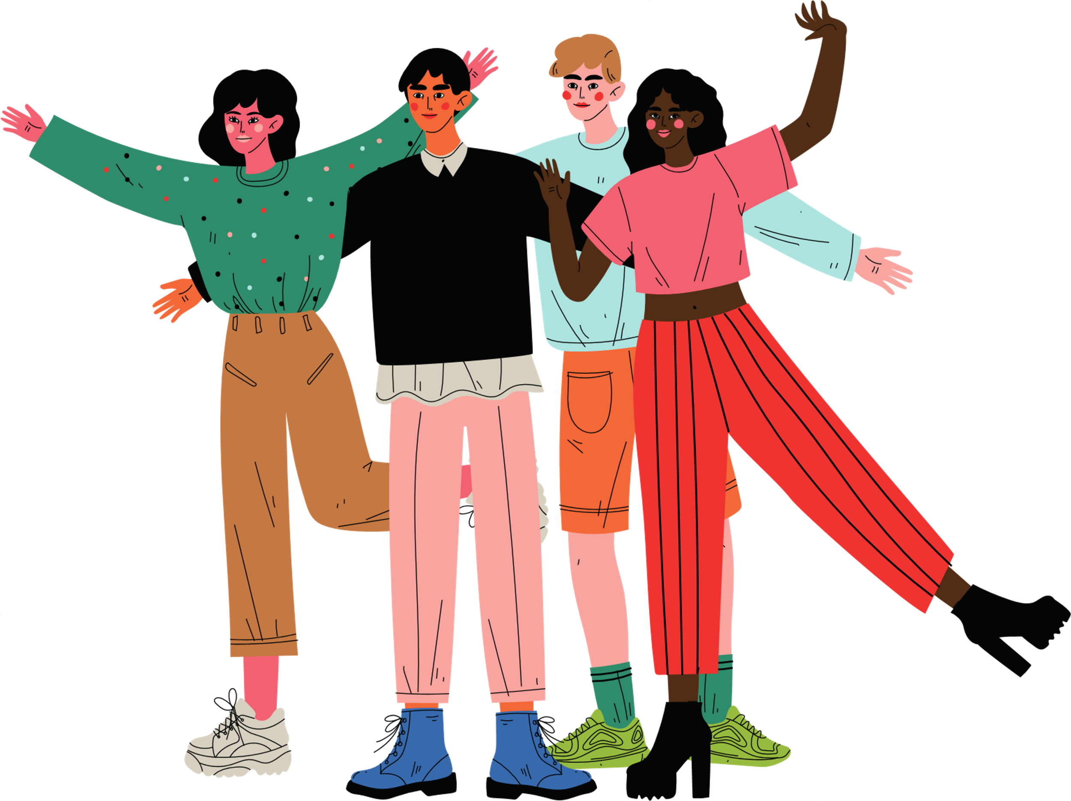

Porn and Representation

Slide 25


(Mainstream)
Porn & Representation
Not all bodies are treated the same way.
  Women
  People of color
  People with disabilities
  LGBTQ+ community
Shallow and limited
representations.

Slide 26
Porn & Representation
Sexual objectification.
See the person as a sexual object.
When a person's body and sexuality are separated from all of their other characteristics and used for someone's sexual gratification. [11]

Slide 27
Porn & Representation
See next slide for a hint!
Reflection Qs
Is pornography the only media where women are objectified?
Are women the only people who are objectified in pornography?

Slide 28
Porn & Representation
Reflection Qs
HINT: Sexual objectification can happen across any and all forms of media, and usually happens to people from minority groups or groups that have experiences sexism, racism, homophobia, and transphobia.

Slide 29
Porn & Representation
Sexual objectification.
See the person as a sexual object.
When a person's body and sexuality are separated from all of their other characteristics and used for someone's sexual gratification. [11]
Fetishization.
Use stereotypes and the person's sexuality to get views.
A type of sexual objectification where a specific part of a person’s identity is sexualized.

Slide 30
Porn & Representation
See next slide for a hint!
Reflection Qs
What other media might have limiting representations of women, people of color and LGBTQ+ people?

Slide 31
Porn & Representation
Reflection Qs
HINT: Do you know any songs, music videos, books, or podcasts that present women, people of color and LGBTQ+ people in limiting ways?

Slide 32
Thinking Critically!

Slide 33
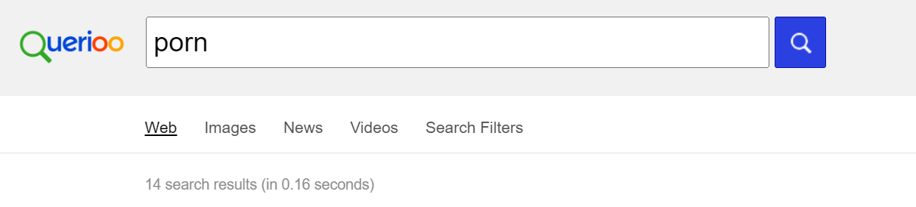
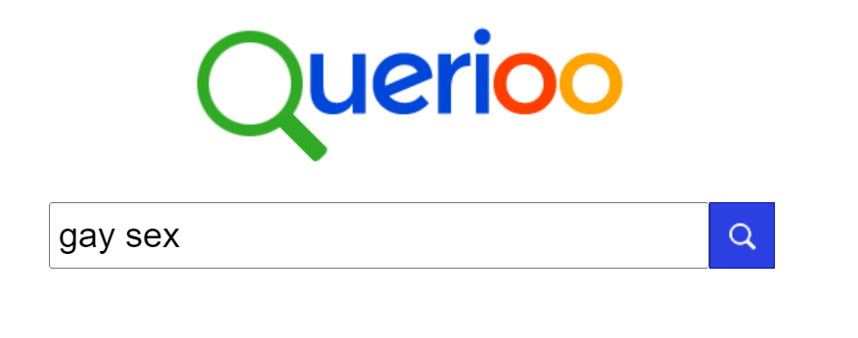
What does your search history
say about you?

Slide 34
What does your search history
say about you?
Not much!
Porn is fiction.
Porn is fantasy.
Porn is not real sex.

Slide 35
If you see something you don't like...
Porn is made for adults, and has adult themes.
Porn can reinforce harmful stereotypes about different groups of people.
Talk to someone about it.
Porn can bring up bad emotions and negative past experiences.

Slide 36
To learn more!
If you have more questions about pornography, you can visit these porn literacy websites for teens:
https://whatsupwithporn.wordpress.com/
OR https://itstimewetalked.com/
For more information about media literacy, visit: https://www.medialit.org/
For parents and educators: https://thepornconversation.org/

Slide 37
References
[1] Center for Media Literacy. (n.d.) The on-ramp to media literacy [Online course]. https://www.medialit.org/courses
[2] Medium. (n.d.). In Merriam-Webster online. Retrieved July 3, 2022, from https://www.merriam-webster.com/dictionary/medium
[3] School of Sexuality Education. (2021). Sex ed: An inclusive teenage guide to sex and relationships. Walker Books.
[4] Action Canada for Sexual Health & Rights. (2017). Pornography. In Beyond the basics: A resource for educators on sexuality and sexual health (3rd ed., p. 545).
[5] Criminal Code, R.S.C., C-46, s. 162 (1985). Retrieved from https://laws-lois.justice.gc.ca/eng/acts/c-46/page-23.html#docCont 20200917-the-fine-line-between-art-and-pornography
[6] Criminal Code, R.S.C., C-46, s. 163 (1985). Retrieved from https://laws-lois.justice.gc.ca/eng/acts/c-46/page-23.html#docCont

Slide 38
[7] Weir, K. (2014, April). Is pornography addictive? Monitor on Psychology, 45(4). https://www.apa.org/monitor/2014/04/pornography
[8] Gupta, S. (2021, May 7). Pornography addiction is not real according to leading psychologists – here’s when porn can be healthy. Insider. https://www.insider.com/guides/health/mental-health/porn-addiction#:~:text=Porn%20addiction%20is%20not%20a,life%20or%20relationships%2C%20seek%20therapy
[9] Wong, B. (2019, April 30). All the ways porn lied to you, according to actual porn stars. Huffpost online. Retrieved from https://www.huffpost.com/entry/porn-lies-sex_l_5cc1ffeee4b066119de3a45c
[10] Alice O. (2022, June 24). Bare bodies: Reality checking mainstream porn. Scarleteen. Retrieved from https://www.scarleteen.com/article/politics_sexual_identity_sexuality/bare_bodies_reality_checking_mainstream_porn_part_one
[11] Rooney, E. (n.d.). The effects of sexual objectification on women’s mental health. Applied psychology OPUS. Retrieved Aug. 17, 2002, from https://wp.nyu.edu/steinhardt-appsych_opus/the-effects-of-sexual-objectification-on-womens-mental-health/#:~:text=Sexual%20objectification%20occurs%20when%20a,Fredrickson%20%26%20Roberts%2C%201997).

Slide 39

Other sources
  Alder, J., Daley, N., & Rothman, E.F. (n.d.). The truth about pornography: A pornography-literacy curriculum for high school students designed to reduce sexual and dating violence [Online course]. https://catalogisee.myshopify.com/products/the-truth-about-pornography-a-pornography-literacy-curriculum-for-high-school-students-designed-to-reduce-sexual-and-dating-violence?variant=40642550792348
  Enfield, L. (2020, September 17). The fine line between art and pornography. BBC. https://www.bbc.com/culture/article/20200917-the-fine-line-between-art-and-pornography
  Klaassen, M.J., & Peter, J. (2014). Gender (in)equality in Internet pornography: A content analysis of popular pornographic Internet videos. The Journal of Sex Research, 52(7), 721-735. https://doi.org/10.1080/00224499.2014.976781
  What’s Up With Porn? (n.d.) https://whatsupwithporn.wordpress.com/
Developed by Taylor Gadoury
in collaboration with the Sexual Health Network of Quebec. 2022.

